Slide 1
What is Algorithm?
To solve a problem, the computer needs to be instructed what and how to do.
Algorithm is a procedure or set of ordered steps to be used to accomplish a task.
You need to write a program in some language syntax

Slide 2
3 Classes Algorithms
With respect to Data Science, following are 3 classes of Algorithms
Data Munging, preparation and processing algorithms - Data Engg
Optimization Algorithms such stochastic gradient descent, Newton’s method and Least squares – Parameters Estimation
Machine Learning Algorithms

Slide 3
What is Machine Learning?
Machine Learning is a type of Artificial Intelligence that provides the computers to self learn without being explicitly programed.
Machine learning algorithms are largely used to Predict, Classify or Cluster

Slide 4
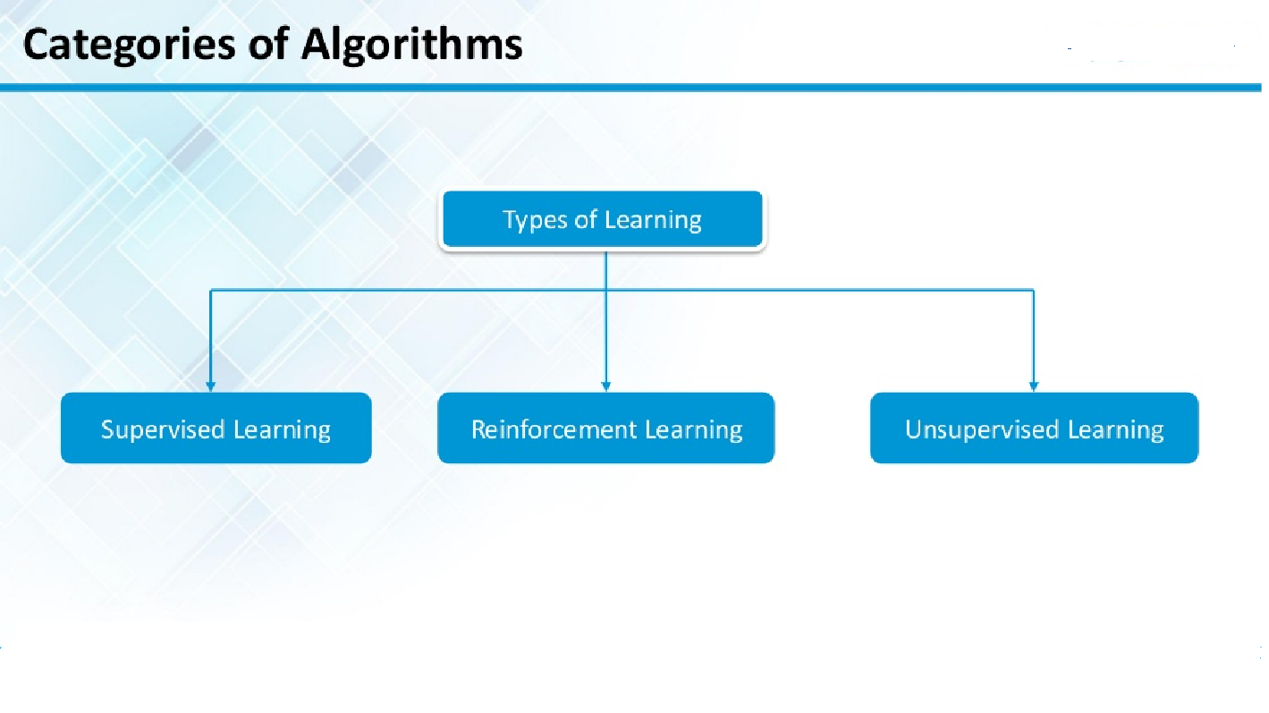
Types of Machine Learning

Slide 5
3 Basic Algoritms
Linear Regression - Prediction
K Nearest Neighbour - Classification
K Means - Cluster
Real challenge for Data Scientist is understanding which ones to use depending on the context of the problem and underlying assumptions

Slide 6
Linear Regression
Applied Business Forecasting and Planning

Slide 7
Simple Regression
Simple regression analysis is a statistical tool That gives us the ability to estimate the mathematical relationship between a dependent variable (usually called y) and an independent variable (usually called x).
The dependent variable is the variable for which we want to make a prediction.
While various non-linear forms may be used, simple linear regression models are the most common.

Slide 8
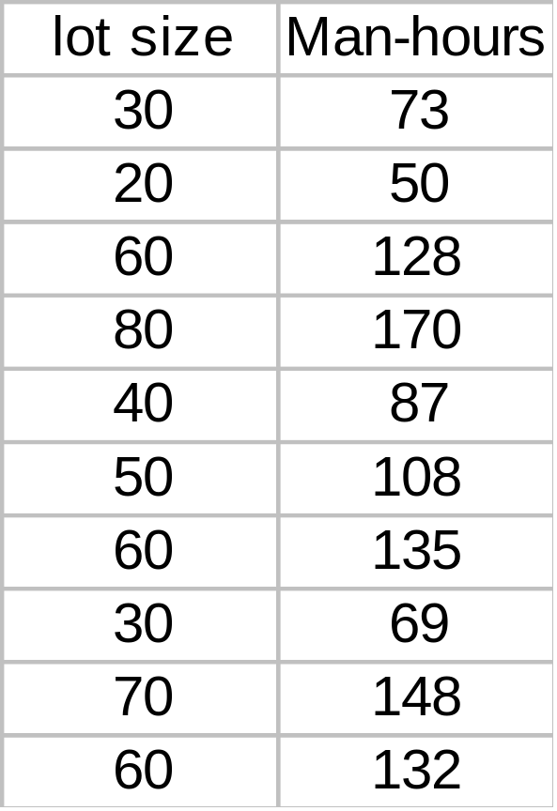
Introduction
The primary goal of quantitative analysis is to use current information about a phenomenon to predict its future behavior.
Current information is usually in the form of a set of data.
In a simple case, when the data form a set of pairs of numbers, we may interpret them as representing the observed values of an independent (or predictor ) variable X and a dependent ( or response) variable Y.
Notes:
In the table on the right the response variable Y represents the man-hours of labor for manufacturing a certain product in lots (X) that vary in size as demand fluctuates.

Slide 9
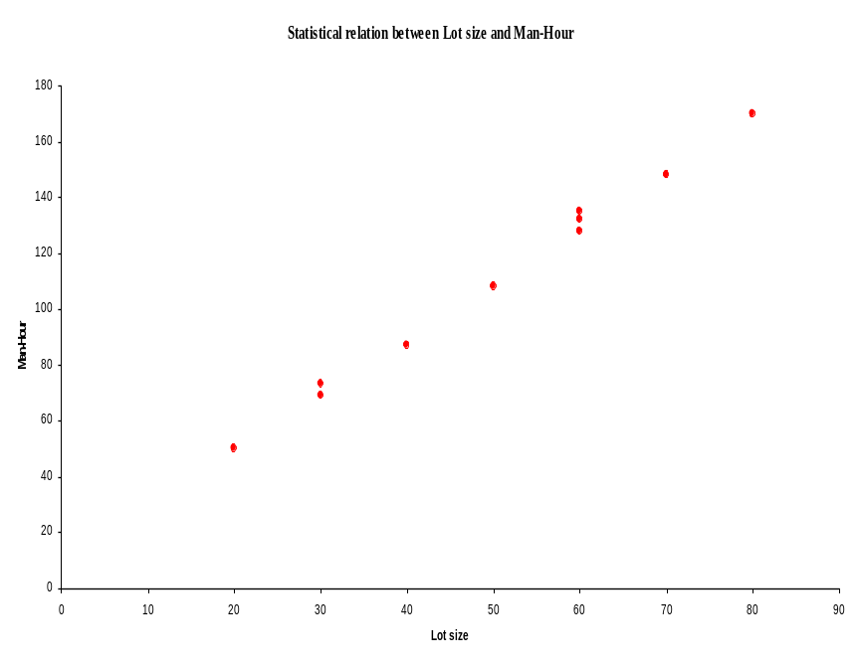

Introduction
The goal of the analyst who studies the data is to find a functional relation
between the response variable y and the predictor variable x.
Notes:
The data in this example concerns 10 recent production runs of a spare part manufactured by the Westwood company.
Notice that for some values of X (X=30 and X=60) there correspond more than one value of Y. This is not an ordinary functional relationship between X and Y, where to each value of X a unique value of Y must correspond.
Question: What is a plausible way of thinking about this situation that would still lead to a model y=F(X) in which we would have a unique value y for each value of X?

Slide 10
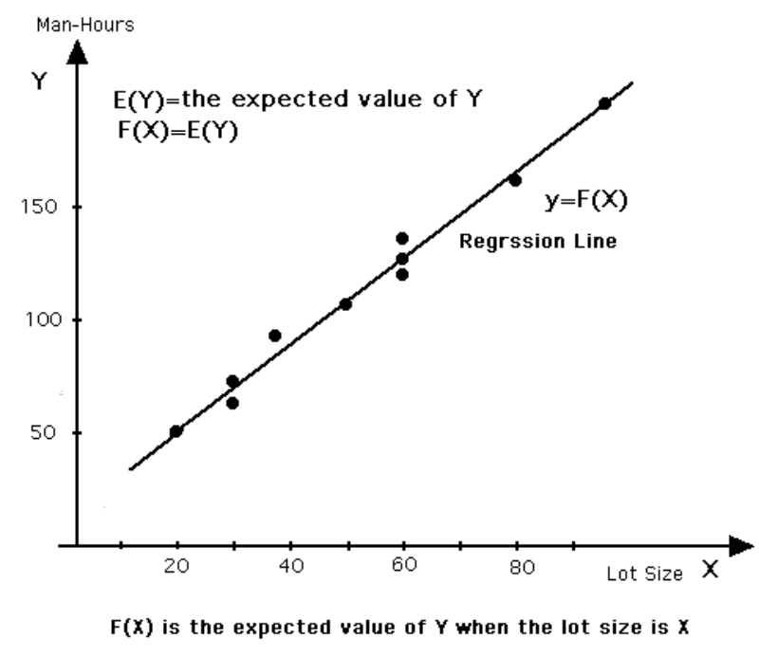

Regression Function
The statement that the relation between X and Y is statistical should be interpreted as providing the following guidelines:
1. Regard Y as a random variable.
2. For each X, take f (x) to be the expected value (i.e., mean value) of y.
3. Given that E (Y) denotes the expected value of Y, call the equation
the regression function.
Notes:
The idea behind this is: when we have several values of y observed for one value of X we take the average of these values of y to assign to x.
This underlying idea is refined and made sophisticated by what we call the theory of regression. According to this theory, we should
1. Decide what distribution y has (often taken to be normal)
2.decide what form F(x) has ( here we have taken it to be a line.
And then we use the data to estimate the parameters of our line in such a way that the expectation of Y-f(x) is minimized.

Slide 11
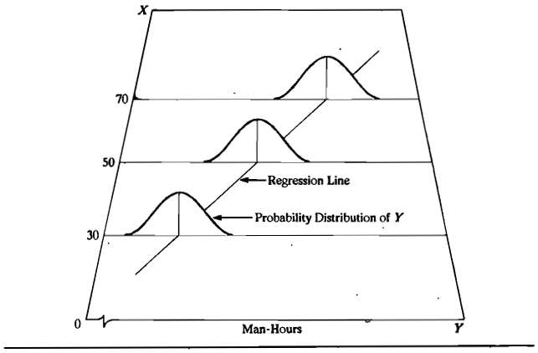
Pictorial Presentation of Linear Regression Model
Notes:
The number of man-hours Y is treated in a regression model as a random variable.
For each lot size, there is postulated a probability distribution of Y.
This figure shows a probability distribution for X= 30, X=50, and X=70.
The actual number of man-hours Y is then viewed as a random selection from this probability distribution.
The means of the probability distributions have a systematic relation to the level of X. This systematic relationship is called the regression function of Y on X. The graph of regression function is called regression curve.
In this figure the regression function is linear. This implies that the mean number of man-hours varies linearly with lot size.

Slide 12
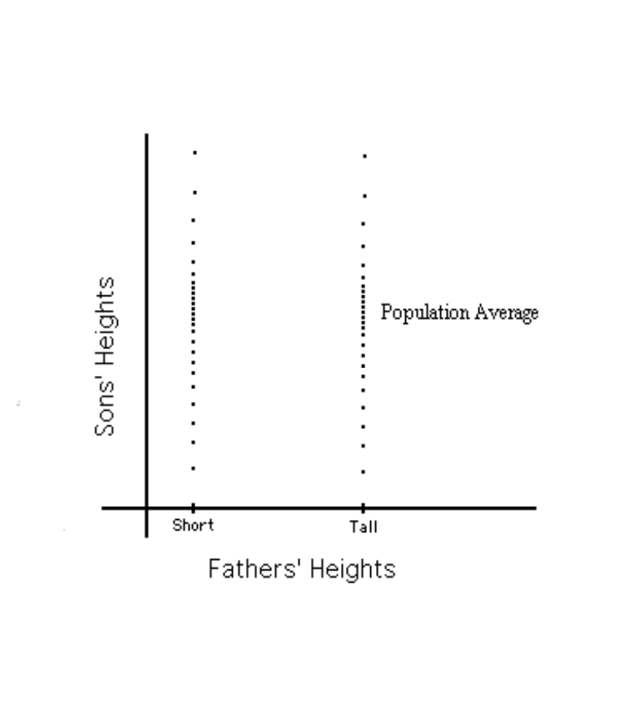
Historical Origin of Regression
Regression Analysis was first developed by Sir Francis Galton, who studied the relation between heights of sons and fathers.
Heights of sons of both tall and short fathers appeared to “revert” or “regress” to the mean of the group.
Notes:
1. In the latter part of 19th century
He considered this tendency to be a regression to “mediocrity.
He developed a mathematical description of this regression tendency.
Galton’s Model is the precursor of today’s regression models.

Slide 13
Construction of Regression Models
Selection of independent variables
  Since reality must be reduced to manageable proportions whenever we construct models, only a limited number of independent or predictor variables can or should be included in a regression model. Therefore a central problem is that of choosing the most important predictor variables.
Functional form of regression relation
  Sometimes, relevant theory may indicate the appropriate functional form. More frequently, however, the functional form is not known in advance and must be decided once the data have been collected and analyzed.
Scope of model
  In formulating a regression model, we usually need to restrict the coverage of model to some interval or region of values of the independent variables.

Slide 14
Uses of Regression Analysis
Regression analysis serves Three major purposes.
    Description
    Control
    Prediction
The several purposes of regression analysis frequently overlap in practice
Notes:
In the study of branch office operating costs, the purpose was administrative control; by developing a usable statistical relation between costs and independent variable s in the system, management was able to set cost standard for each branch office in the company chain.
The west wood Company lot size example, the knowledge of the relation between lot size and man-hours in past production runs enables management to predict the man-hours for the next production run of a given lot size, for purposes of cost estimation and production scheduling.
After the run is completed, management can compare the actual man-hours against the predicted hours for purposes of administrative control

Slide 15
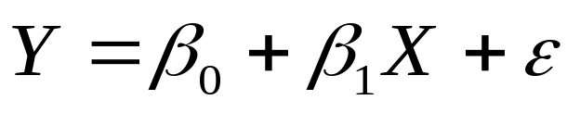
Formal Statement of the Model
General regression model
    β₀, and β₁ are parameters
    X is a known constant
    Deviations ε are independent N(o, σ²)

Slide 16
Meaning of Regression Coefficients
The values of the regression parameters β₀, and β₁ are not known.We estimate them from data.
β₁ indicates the change in the mean response per unit increase in X.

Slide 17

Regression Model
If the scatter plot of our sample data suggests a linear relationship between two variables i.e.
we can summarize the relationship by drawing a straight line on the plot.
Least squares method give us the “best” estimated line for our set of sample data.

Slide 18
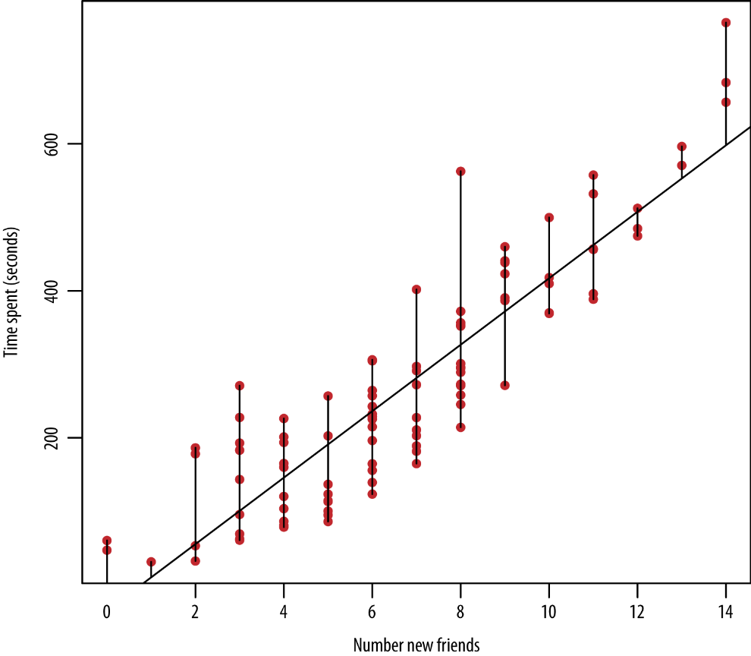
Regression Model

Slide 19

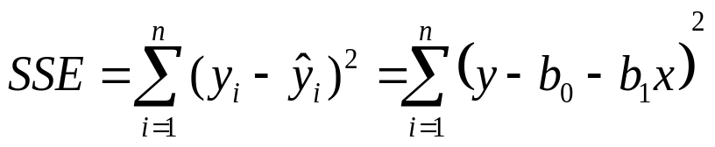
Regression Line
We will write an estimated regression line based on sample data as
The method of least squares chooses the values for b₀, and b₁ to minimize the sum of squared errors

Slide 20
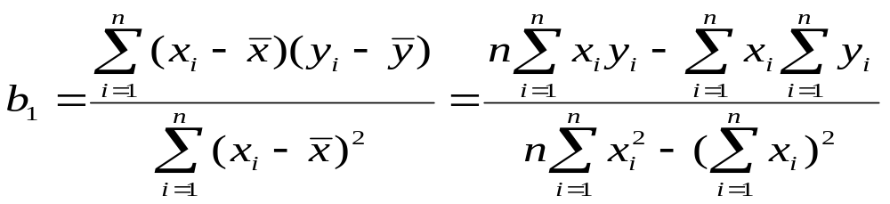
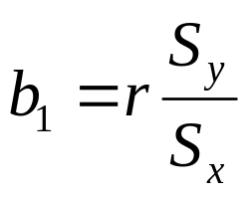
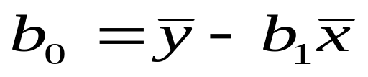
Regression Line
Using calculus, we obtain estimating formulas:
or

Slide 21
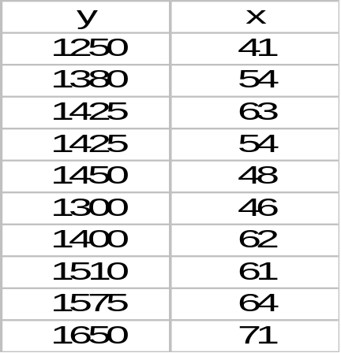
Estimation of Mean Response
Fitted regression line can be used to estimate the mean value of y for a given value of x.
Example
  The weekly advertising expenditure (x) and weekly sales (y) are presented in the following table.

Slide 22
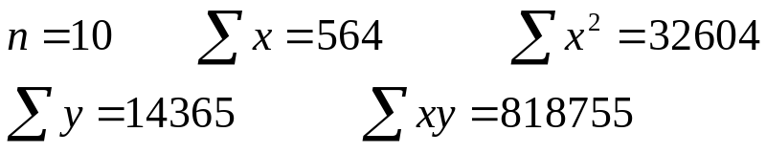
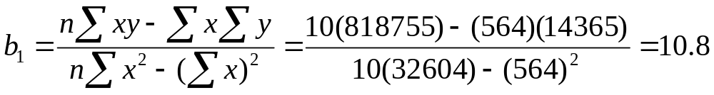
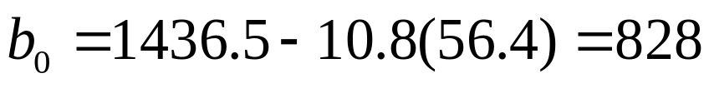
Point Estimation of Mean Response
  From previous table we have:
  The least squares estimates of the regression coefficients are:

Slide 23
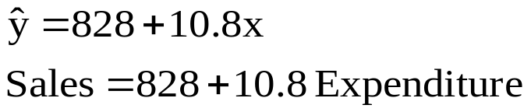
Point Estimation of Mean Response
  The estimated regression function is:
  This means that if the weekly advertising expenditure is increased by $1 we would expect the weekly sales to increase by $10.8.

Slide 24

Point Estimation of Mean Response
Fitted values for the sample data are obtained by substituting the x value into the estimated regression function.
For example if the advertising expenditure is $50, then the estimated Sales is:
This is called the point estimate (forecast) of the mean response (sales).

Slide 25
Example: Retail sales and floor space
It is customary in retail operations to asses the performance of stores partly in terms of their annual sales relative to their floor area (square feet). We might expect sales to increase linearly as stores get larger, with of course individual variation among stores of the same size. The regression model for a population of stores says that
SALES = β₀ + β₁× AREA + ε

Slide 26
Example : Retail sales and floor space
The slope β₁ is as usual a rate of change: it is the expected increase in annual sales associated with each additional square foot of floor space.
The intercept β₀ is needed to describe the line but has no statistical importance because no stores have area close to zero.
Floor space does not completely determine sales. The term ε in the model accounts for difference among individual stores with the same floor space. A store’s location, for example, is important.

Slide 27


Residuals
The difference between the observed value y_{i} and the corresponding fitted value .
Residuals are highly useful for studying whether a given regression model is appropriate for the data at hand.

Slide 28
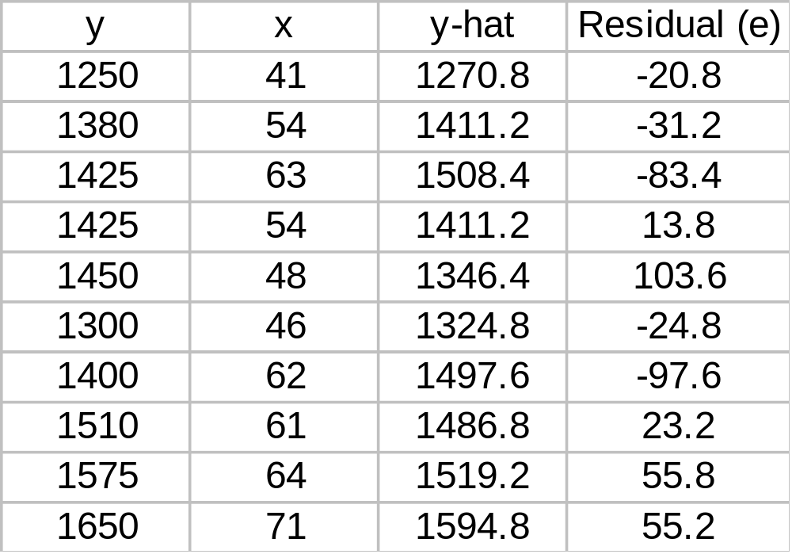
Example: weekly advertising expenditure

Slide 29
Estimation of the variance of the error terms, σ²
The variance σ² of the error terms ε_{i} in the regression model needs to be estimated for a variety of purposes.
  It gives an indication of the variability of the probability distributions of y.
  It is needed for making inference concerning regression function and the prediction of y.

Slide 30
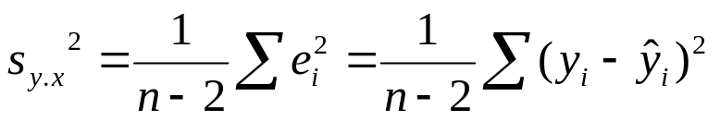
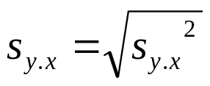
Regression Standard Error
To estimate σ we work with the variance and take the square root to obtain the standard deviation.
For simple linear regression the estimate of σ² is the average squared residual.
To estimate σ , use
s estimates the standard deviation σ of the error term ε in the statistical model for simple linear regression.

Slide 31
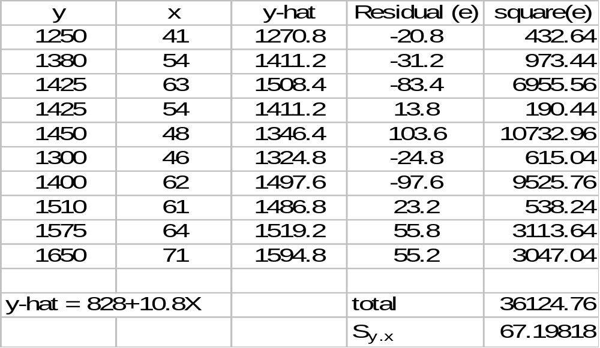
Regression Standard Error

Slide 32
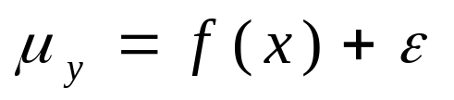
Basic Assumptions of a Regression Model
A regression model is based on the following assumptions:
    There is a probability distribution of Y for each level of X.
    Given that µ_{y} is the mean value of Y, the standard form of the model is
    where ε is a random variable with a normal distribution with mean 0 and standard deviation σ.

Slide 33
Conditions for Regression Inference
You can fit a least-squares line to any set of explanatory-response data when both variables are quantitative.
If the scatter plot doesn’t show an approximately linear pattern, the fitted line may be almost useless.

Slide 34
Conditions for Regression Inference
The simple linear regression model, which is the basis for inference, imposes several conditions.
We should verify these conditions before proceeding with inference.
The conditions concern the population, but we can observe only our sample.

Slide 35
Conditions for Regression Inference
In doing Inference, we assume:
  The sample is an SRS from the population.
  There is a linear relationship in the population.
    We can not observe the population , so we check the scatter plot of the sample data.
  The standard deviation of the responses about the population line is the same for all values of the explanatory variable.
    The spread of observations above and below the least-squares line should be roughly uniform as x varies.

Slide 36
Conditions for Regression Inference
Plotting the residuals against the explanatory variable is helpful in checking these conditions because a residual plot magnifies patterns.

Slide 37




Inference about the Regression Model
We will write the population regression line as
  The numbers and are parameters that describe the population.
We will write the least-squares line fitted to sample data as
  This notation reminds us that the intercept b₀ of the fitted line estimates the intercept β₀ of the population line, and the slope b₁ estimates the slope β₁ .

Slide 38
K Nearest Neighbors Algorithm
Different Names of KNN Algorithm
• K-Nearest Neighbors
• Memory-Based Reasoning
  • Example-Based Reasoning
• Instance-Based Learning
• Lazy Learning

Slide 39
What is KNN?
A powerful classification algorithm used in pattern recognition.
K nearest neighbors stores all available cases and classifies new cases based on a similarity measure(e.g distance function)
One of the top data mining algorithms used today.
A non-parametric lazy learning algorithm (An Instance based Learning method).

Slide 40
KNN: Classification Approach
An object (a new instance) is classified by a majority votes for its neighbor classes.
The object is assigned to the most common class amongst its K nearest neighbors. (measured by a distant function)

Slide 41
Features of KNN Algorithm
KNN is a Supervised Learning algorithm that uses labeled input data set to predict the output of the data points.
It is one of the most simple Machine learning algorithms and it can be easily implemented for a varied set of problems.
It is mainly based on feature similarity. KNN checks how similar a data point is to its neighbor and classifies the data point into the class it is most similar to.

Slide 42
Features of KNN Algorithm
Unlike most algorithms, KNN is a non-parametric model which means that it does not make any assumptions about the data set. This makes the algorithm more effective since it can handle realistic data.
KNN is a lazy algorithm, this means that it memorizes the training data set instead of learning a discriminative function from the training data.
KNN can be used for solving both classification and regression problems.

Slide 43
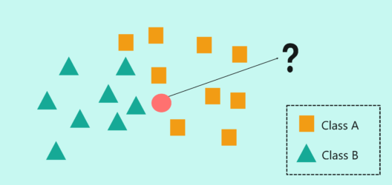
KNN Algorithm Example
• In the above image, we have two classes of data, namely class A (squares) and Class B (triangles)
• The problem statement is to assign the new input data point to one of the two classes by using the KNN algorithm

Slide 44
KNN Algorithm Example
The first step in the KNN algorithm is to define the value of ‘K’. But what does the ‘K’ in the KNN algorithm stand for?
‘K’ stands for the number of Nearest Neighbors and hence the name K Nearest Neighbors (KNN).
But what if the ‘K’ value is set to 7? Here, I’m basically telling my algorithm to look for the seven nearest neighbors and classify the new data point into the class it is most similar to.

Slide 45
KNN Algorithm Example
At ‘K’ = 7, the neighbors include 3 squares and 4 triangles. So, if I were to classify the new data point based on ‘K’ = 7, then it would be assigned to Class B (triangles) since the majority of its neighbors were of class B.
KNN uses Euclidean distance as a measure to check the distance between a new data point and its neighbors.
Consider the above image, here we’re going to measure the distance between P1 and P2 by using the Euclidian Distance measure.

Slide 46
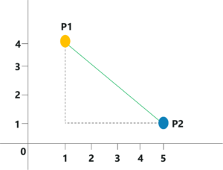
KNN Algorithm Example
The coordinates for P1 and P2 are (1,4) and (5,1) respectively.
The Euclidian Distance can be calculated like so:

Slide 47
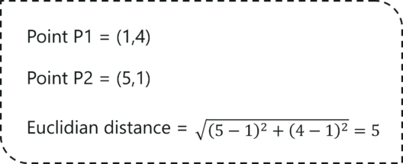
KNN Algorithm Example
It is as simple as that! KNN makes use of simple measure in order to solve complex problems, this is one of the reasons why KNN is such a commonly used algorithm. To sum it up, let’s look at the pseudo-code for KNN Algorithm.

Slide 48
KNN Algorithm Pseudo-code
Consider the set, (Xi, Ci),
Where Xi denotes feature variables and ‘i’ are data points ranging from i=1, 2, ….., n
Ci denotes the output class for Xi for each I
The condition, Ci ∈ {1, 2, 3, ……, c} is acceptable for all values of ‘i’ by assuming that the total number of classes is denoted by ‘c’.
Now let’s pretend that there’s a data point ‘x’ whose output class needs to be predicted. This can be done by using the K-Nearest Neighbour (KNN)

Slide 49
KNN Algorithm Pseudo-code
Calculate D(x, xi), where 'i' =1, 2, ….., n and 'D' is the Euclidean measure between the data points.
The calculated Euclidean distances must be arranged in ascending order.
Initialize k and take the first k distances from the sorted list.
Figure out the ‘K’ points for the respective ‘K’ distances.

Slide 50
KNN Algorithm Pseudo-code
Calculate ki, which indicates the number of data points belonging to the ith class among k points i.e. k ≥ 0 If ki > kj ∀ i ≠ j; put x in class i.

Slide 51
K Means Algorithm Features
K-means clustering is a type of unsupervised machine learning, which is used when you have unlabeled data (i.e., data without defined categories or groups).
The goal of this algorithm is to find groups in the data, with the number of groups represented by the variable K.
The algorithm works iteratively to assign each data point to one of K groups based on the features that are provided. Data points are clustered based on feature similarity.

Slide 52
Applications of K Means
The K-means clustering algorithm is used to find groups which have not been explicitly labeled in the data. This versatile algorithm can be applied to various application like
Behavioral segmentation:
  Segment by purchase history
  Segment by activities on application, website, or platform
  Define personas based on interests
  Create profiles based on activity monitoring

Slide 53
Applications of K Means
Inventory categorization:
  Group inventory by sales activity
  Group inventory by manufacturing metrics
  Sorting sensor measurements:
  Detect activity types in motion sensors
  Group images
  Separate audio
  Identify groups in health monitoring

Slide 54
Applications of K Means
Detecting bots or anomalies:
  Separate valid activity groups from bots
  Group valid activity to clean up outlier detection

Slide 55
Steps in K Means Algorithm
1. Select K
2. Randomly select initial cluster seeds
An initial cluster seed represents the “mean
value” of its cluster.
3. Calculate distance from each object to each cluster seed.
4. Compute the new centroid for each cluster
5. Iterate:
  Calculate distance from objects to cluster

Slide 56
Steps in K Means Algorithm
  centroids.
  Assign objects to closest cluster
  Recalculate new centroids
Stop based on convergence criteria
  No change in clusters
  Max iterations
Distance measure is squared Euclidean
  Scale should be similar in all dimensions
    Rescale data?
  Not good for nominal data. Why?

Slide 57
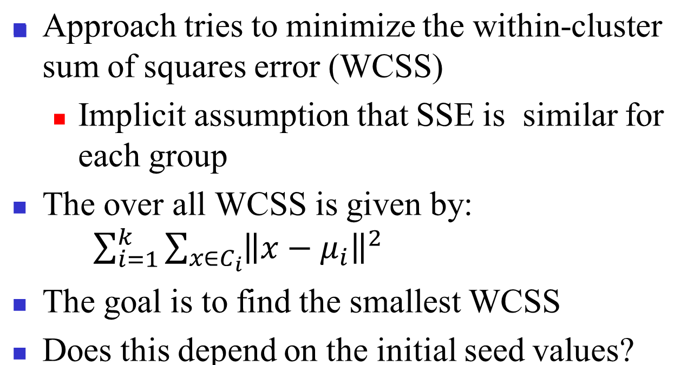
Steps in K Means Algorithm

Slide 58
Logistic Regression
Logistic regression is one of the most popular machine learning algorithms for binary classification.
This is because it is a simple algorithm that performs very well on a wide range of problems.
Logistic Function defined as T = 1 / (1 + e^-x)
‘e’ is Euler’s constant and ‘x’ is an input.
Let us plug in a series numbers from -5 to 5 in to x
and compute the values of T for each value of x

Slide 59
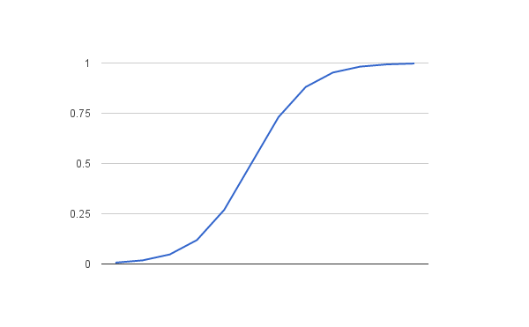
Logistic Function
x T
-5 0.006692850924
-4 0.01798620996
-3 0.04742587318
-2 0.119202922
-1 0.2689414214
0 0.5
1 0.7310585786
2 0.880797078
3 0.9525741268
4 0.98201379
5 0.9933071491

Slide 60
Logistic Regression Model
The logistic regression model takes real-valued inputs and makes a prediction as to the probability of the input belonging to the default class (class 0).
If the probability is < 0.5 we can take the output as a prediction for the default class (class 0), otherwise the prediction is for the other class (class 1).
The job of the learning algorithm will be to discover the best values for the coefficients (b0, b1 and b2) based on the training data.

Slide 61
Logistic Regression Model
Consider the data set
X1 X2 Y
2.7810836 2.550537003 0
1.465489372 2.362125076 0
3.396561688 4.400293529 0
1.38807019 1.850220317 0
3.06407232 3.005305973 0
7.627531214 2.759262235 1
5.332441248 2.088626775 1
6.922596716 1.77106367 1
8.675418651 -0.2420686549 1
7.673756466 3.508563011 1

Slide 62
Logistic Regression Model
For this dataset, the logistic regression has three coefficients just like linear regression, for example:
output = b0 + b1*x1 + b2*x2
The job of the learning algorithm will be to discover the best values for the coefficients (b0, b1 and b2) based on the training data.
Unlike linear regression, the output is transformed into a probability using the logistic function:

Slide 63
Stochastic Gradient Descent
p(class=0) = 1 / (1 + e^(-output))
We can estimate the values of the coefficients using stochastic gradient descent.
It works by using the model to calculate a prediction for each instance in the training set and calculating the error for each prediction.
Given each training instance: Calculate
1 A prediction using the current values of the coefficients.
2 New coefficients based on the error in the prediction.

Slide 64
Calculate Prediction
The process is repeated until the model is accurate enough (e.g. error drops to some desirable level) or for the fixed number of iterations.
Let’s start off by assigning 0.0 to each coefficient and calculating the probability of the first training instance that belongs to class 0. B0 = 0.0, B1 = 0.0, B2 = 0.0
We calculate a prediction with the first training example x1=2.7810836, x2=2.550537003, Y=0
prediction = 1 / (1 + e^(-(b0 + b1*x1 + b2*x2)))
prediction = 1 / (1 + e^(-(0.0 + 0.0*2.7810836 + 0.0*2.550537003)))
prediction = 0.5

Slide 65
Calculate New Coefficients
Simple coefficient update equation:
b = b + α * (y – prediction) * prediction * (1 – prediction) * x
Where ‘b’ is the coefficient we are updating and prediction is the output of making a prediction using the model.
‘α’ is parameter known as learning rate which you must specify at the beginning of the training run. It controls how much the coefficients (and therefore the model) changes or learns each time it is updated. Good value of α are between 0.1 to 0.3.
Let us use α = 0.3
The coefficient b0 do not have input and is called Bias or Intercept. We can assume b0 always has an input = 1.0

Slide 66
Computed Model
Let’s update the coefficients using the prediction (0.5) and coefficient values (0.0) from the previous section. b0 = b0 + 0.3 * (0 – 0.5) * 0.5 * (1 – 0.5) * 1.0
b1 = b1 + 0.3 * (0 – 0.5) * 0.5 * (1 – 0.5) * 2.7810836
b2 = b2 + 0.3 * (0 – 0.5) * 0.5 * (1 – 0.5) * 2.55053700
b0 = -0.0375; b1 = -0.104290635; b2 = -0.09564513761
We can repeat this process and update the model for each training instance in the dataset.
A single iteration through the training dataset is called an epoch. It is common to repeat the stochastic gradient descent procedure for a fixed number of epochs.

Slide 67
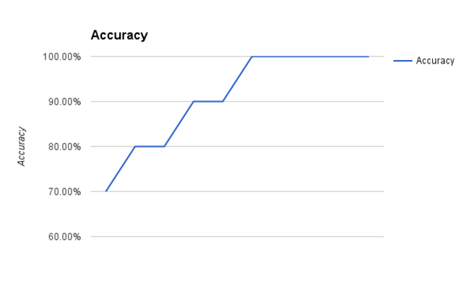
Computed Model
The coefficients calculated after 10 epochs of stochastic gradient descent are:
b0 = -0.4066054641 b1 = 0.8525733164 b2 = -1.104746259
The graph below shows plot of accuracy of the model for 10 epochs.

Slide 68
Classifiers
Classification involves mapping your data points into a finite set of labels or the probability of a given label or labels.
Some examples of classification algorithms
  Naïve Bayes
  K-nearest neighbour
  Logistic regression
  Decision trees
  Random forests
  Support Vector Machine

Slide 69
Classifier Example Questions and answers
Will some click on this ad? 0 or 1 no or yes
What no. is this (image recognition)? 0, 1, 2, etc
What is this news article about? “Sports”
Is this spam? 0 or 1 no or yes
Is this pill good for headache? 0 or 1 no or yes
Given Data, real-world classification problem and constraints, you need to determine:
Which classifier to use?
Which optimization method to employ?

Slide 70
Which loss function to minimize?
Which features to take from the data?
Which evaluation metric to use?
One way to address the first question is to try all the classification algorithms and choose the one with best performance.
This is fine for limited data and with no constraints. But constraints are a big deal. You may have tons of data or not much time or both.

Slide 71
Runtime
When you have massive data, caring about various speed issues becomes necessary. Some speed issues are like
How long it takes to update a model?
How long it takes to use a model to actually make a decision if you already have it.
The second question is usually more important and is called “Runtime”.
Some algorithms are slow at runtime e.g. K-NN.

Slide 72
Real understanding the algorithm
Linear models are very fast both to update and to use at runtime.
Getting the best-fit of an algorithm often requires intimate knowledge of the said algorithm.
Common mistake for people not completely familiar with an algorithm is to over-fit.

Slide 73
Interpretability and Scalability
You often need to be able to interpret your model for the sake of the business.
Decision trees are very easy to interprete and Random forests are not.
3 things to keep in mind when considering scalability.
Learning time: How much time does it take to train the model?
Scoring time: How much time does it take to give a new user a score once the model is in production?
Model Storage: How much memory does the production model use up?

Slide 74
M6D Logistic Regression : Case Study
3 core problems for Data scientist at M6D
  Feature Engineering: Figuring out which features to use and how to use them
  User-level conversion prediction: Forecasting when someone will click
  Bidding: How much it is worth to show a given ad to a given user?
  They need to match the clients which represent advertising companies to individual users.
  They target ads to users based on a user’s likelihood to click.

Slide 75


